Slide 1
Euro PDT 2013 highlights
Madrid, May 31st - June 1st

Slide 2
Hot topics 2013
New guidelines and consensus
New guidelines for PDT. LR Braathen, Switzerland and CA Morton, UK
German consensus on PDT for skin rejuvenation. RM Szeimies, Germany
Daylight-PDT
Efficacy and safety of MAL cream activated by natural daylight in AK: a randomized, investigator blinded, controlled, phase 3 study. S Shumack, Australia
Daylight PDT for leishmaniasis. CD Enk, Israel
Optimizing the amount of Metvix® used in daylight PDT. HC Wulf, Denmark
Latest news
Pulsed Dye Laser mediated photodynamic therapy for actinic keratosis: Results of a randomized clinical trial. J Kessels, The Netherlands
PDT with nitrous oxide sedation. I Polimón-Olabarrieta, Spain
A randomized trial of PDT, CO2-Laser, diclofenac gel and cryotherapy for AK. PG Calzavara-Pinton, Italy
Comparison of lesion vs. field treatment with PDT in AK prevention: first preliminary results. RMJP Gerritsen, The Netherlands
PDT versus topical imiquimod versus topical 5-fluorouracil for treatment of superficial BCC: a single blind, noninferiority, randomized controlled trial. N Kelleners-Smeets, The Netherlands
Combined Carbon Dioxide Laser with PDT for Nodular and Superficial BCC. MSC Murison, U.K.
Awarded presentation (including posters)
3D Cellular model for PDT outcome research. S Nonell, Spain
Light emitting fabrics for photodynamic therapy of skin. M Vouters, France
Selected posters
Abbreviations

Slide 3
Hot topics 2013
New guidelines and consensus
New guidelines for PDT. LR Braathen, Switzerland and CA Morton, UK
German consensus on PDT for skin rejuvenation. RM Szeimies, Germany
Daylight-PDT
Efficacy and safety of MAL cream activated by natural daylight in AK: a randomized, investigator blinded, controlled, phase 3 study. S Shumack, Australia
Daylight PDT for leishmaniasis. CD Enk, Israel
Optimizing the amount of Metvix® used in daylight PDT. HC Wulf, Denmark
Latest news
Pulsed Dye Laser mediated photodynamic therapy for actinic keratosis: Results of a randomized clinical trial. J Kessels, The Netherlands
PDT with nitrous oxide sedation. I Polimón-Olabarrieta, Spain
A randomized trial of PDT, CO2-Laser, diclofenac gel and cryotherapy for AK. PG Calzavara-Pinton, Italy
Comparison of lesion vs. field treatment with PDT in AK prevention: first preliminary results. RMJP Gerritsen, The Netherlands
PDT versus topical imiquimod versus topical 5-fluorouracil for treatment of superficial BCC: a single blind, noninferiority, randomized controlled trial. N Kelleners-Smeets, The Netherlands
Combined Carbon Dioxide Laser with PDT for Nodular and Superficial BCC. MSC Murison, U.K.
Awarded presentation (including posters)
3D Cellular model for PDT outcome research. S Nonell, Spain
Light emitting fabrics for photodynamic therapy of skin. M Vouters, France
Selected posters
Abbreviations

Slide 4
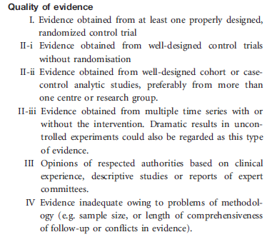
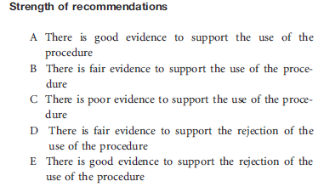
New guidelines for PDT
Lasse R. Braathen, Bern, Switzerland and Colin A. Morton, Stirling, U.K.

Slide 5
New guidelines for PDT
Lasse R. Braathen, Bern, Switzerland and Colin A. Morton, Stirling, U.K.
Part 1: Current indications
- Treatment of NMSC (other than SCC) should be driven by efficacy, with due consideration to cosmetic outcome, and patient preference
- PDT has evidence to support:
- Reliable long term efficacy
- Excellent cosmetic outcomes (with superiority over surgery and cryotherapy)
- Repeated use if required
- PDT is recommended as first-line treatment for AK, BD, sBCC and thin nBCC.
 | Quality of Evidence | Strength of Recommendation
AK | I | A
In situ SCC = BD | I | A
sBCC | I | A
nBCC | I | A

Slide 6
New guidelines for PDT
Lasse R. Braathen, Bern, Switzerland and Colin A. Morton, Stirling, U.K.
Part 2: Emerging indications
… such as field cancerization, photorejuvenation and inflammatory⁄ infective dermatoses.
 | Quality of Evidence | Strength of Recommendation
Treatment of NMSC in OTR | I | B
Prevention of NMSC in OTR | I | B
Field cancerization | I | B
Cutaneous T-cell lymphoma | II-iii | C
Extra-mammary Paget’s disease | III | D
Acne | I | A
Refractory hand and foot warts | I | B
Genital warts | I | B
Cutaneous leishmaniasis | I | B
Photorejuvenation | I | B

Slide 7
German consensus on PDT
for skin rejuvenation
Rolf-Markus Szeimies, Recklinghausen, Germany
Results of a consensus conference of an expert group for aesthetic PDT: publication of 2 articles
Mechanisms: histologically proven increase of collagen and decrease of elastotic material in the dermis.
Well-documented skin rejuvenating effects of PDT with improvement of lentigines, skin roughness, fine lines and sallow complexion, pigmentary changes, erythema
Advantages:
  Simultaneous treatment and possibly prevention of AK
  Possibility of repeated treatments
  Limited and calculable side effects
Definition of 3 treatment zones with chronic sun damage: face, back of the hands and décolleté and recommendations for treatment protocols

Slide 8
German consensus on PDT
for skin rejuvenation
Rolf-Markus Szeimies, Recklinghausen, Germany
Suitable pretreatments and combinations:
  Mild chemical peeling (α-hydroxy acid , salicylic acid): last session 3 days before PDT at the latest
  Mechanical peeling or curettage before PDT
  Ablative fractional lasers before application of photosensitizer either with low power setting (drug penetration) or high power setting (synergistic effects)
  Micro-needling immediately after application of sensitizer
  BTX 2 weeks before PDT at the latest; Fillers 2 weeks after PDT at the earliest
Post-PDT care
  Cooling immediately after treatment ; Wound and scar care; Avoid topical corticosteroids
  Strict sun protection
Repetition / frequency of aesthetic PDT
  No rules have been established
  Usually 2–3 treatments in 3–6-month intervals are performed until satisfactory results are achieved.
  A minimum interval of 4 weeks between individual sessions should be observed
Finally, be careful with therapeutic protocols which do not adhere to the recommendations in case AKs or BCCs are in the target area (i.e. lower photosensitizer concentrations, shorter incubation times, other light sources and fluences).

Slide 9
Hot topics 2013
New guidelines and consensus
New guidelines for PDT. LR Braathen, Switzerland and CA Morton, UK
German consensus on PDT for skin rejuvenation. RM Szeimies, Germany
Daylight-PDT
Efficacy and safety of MAL cream activated by natural daylight in AK: a randomized, investigator blinded, controlled, phase 3 study. S Shumack, Australia
Daylight PDT for leishmaniasis. CD Enk, Israel
Optimizing the amount of Metvix® used in daylight PDT. HC Wulf, Denmark
Latest news
Pulsed Dye Laser mediated photodynamic therapy for actinic keratosis: Results of a randomized clinical trial. J Kessels, The Netherlands
PDT with nitrous oxide sedation. I Polimón-Olabarrieta, Spain
A randomized trial of PDT, CO2-Laser, diclofenac gel and cryotherapy for AK. PG Calzavara-Pinton, Italy
Comparison of lesion vs. field treatment with PDT in AK prevention: first preliminary results. RMJP Gerritsen, The Netherlands
PDT versus topical imiquimod versus topical 5-fluorouracil for treatment of superficial BCC: a single blind, noninferiority, randomized controlled trial. N Kelleners-Smeets, The Netherlands
Combined Carbon Dioxide Laser with PDT for Nodular and Superficial BCC. MSC Murison, U.K.
Awarded presentation (including posters)
3D Cellular model for PDT outcome research. S Nonell, Spain
Light emitting fabrics for photodynamic therapy of skin. M Vouters, France
Selected posters
Abbreviations

Slide 10
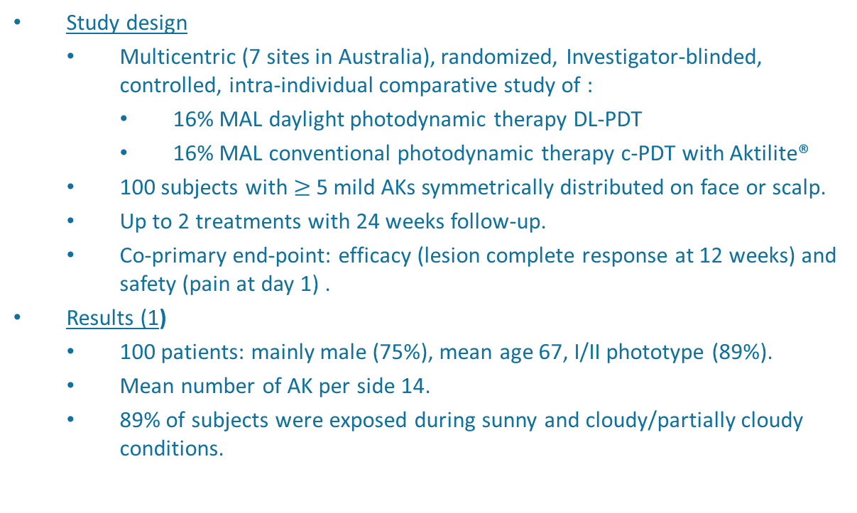
Efficacy and safety of MAL cream activated by natural daylight in AK: a randomized, investigator blinded, controlled, phase 3 study
Stephen Shumack, Kogarah, Australia
Study design
  Multicentric (7 sites in Australia), randomized, Investigator-blinded, controlled, intra-individual comparative study of :
    16% MAL daylight photodynamic therapy DL-PDT
    16% MAL conventional photodynamic therapy c-PDT with Aktilite®
  100 subjects with $≥$5 mild AKs symmetrically distributed on face or scalp.
  Up to 2 treatments with 24 weeks follow-up.
  Co-primary end-point: efficacy (lesion complete response at 12 weeks) and safety (pain at day 1) .
Results (1)
  100 patients: mainly male (75%), mean age 67, I/II phototype (89%).
  Mean number of AK per side 14.
  89% of subjects were exposed during sunny and cloudy/partially cloudy conditions.

Slide 11
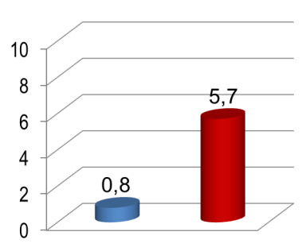
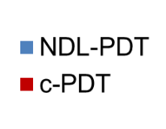
Efficacy and safety of MAL cream activated by natural daylight in AK: a randomized, investigator blinded, controlled, phase 3 study
Stephen Shumack, Kogarah, Australia
Results (2)
  Efficacy on mild AKs: DL-PDT non-inferior to c-PDT: lesion response at 12 weeks: 89 vs 93 % (Per Protocol)
  NDL-PDT significantly less painful : Pain score after 1st session: 0.8 vs 5.7 (p<.001)
  NDL-PDT is better tolerated : % of subject with at least 1 adverse event: 39 vs 59%
  High subject satisfaction, significantly greater with NDL-PDT
  Cosmetic outcome: Good to excellent for both treatment at 12 weeks
Conclusion: MAL daylight PDT is a viable treatment alternative for AK:
  Effective, almost pain free , fewer skin reactions than with c-PDT
  All year long in Australia (excellent meteorological conditions)…
  … whatever weather conditions (except rain)
89
92
  Lesion CR at 12 weeks (Per Protocol: n=90)
Maximal pain assessed after treatment

Slide 12
Daylight PDT for leishmaniasis
Claes David Enk, Jerusalem, Israel
C-PDT has proved efficient for the treatment of cutaneous leishmaniasis (CL); however, it is time-consuming and often painful => Is DL-PDT suitable for the treatment of CL?
Open feasibility study:
  14 patients with 49 non-ulcerated CL lesions (L. major or L. tropica)
  Control: 8 patients (38 lesions) treated with liquid nitrogen (LN)
  Weekly treatment with DL-PDT (MAL cream, 2.5 hours daylight exposure) till cured
  Treatment response assessed by smear and RT-PCR.
Results:
  Mean number of treatments was 5 (maximum 8)
  The overall patient cure rates were 86 % for DL-PDT, 100% for LN.
  DL-PDT treatment failure in 2 patients: both kids with L.tropica facial lesions
  Treatment was almost practically pain-free and left minimal scarring.
Conclusions:
  DL-PDT will make the treatment of CL time effective, and more convenient for the patients (Self-administered? …large-scale applicability in the 3rd World).
  Some questions remain without answer: optimal treatment regimen (light dose, frequency of treatment…), appropriate indication (species susceptibility, anatomical variation,…)

Slide 13
Optimizing the amount of Metvix®
in daylight PDT
Hans Christian Wulf, Copenhagen, Denmark
How much of Metvix® is used in real life?
  Background for the treatment of AK:
    1mm thick layer (100 mg/cm²) is the recommended dose according to Metvix® Summary of Product Characteristics: lesion-based treatment, conventional PDT
    0,5 mm thick layer (40-50 mg/cm²) is the amount of Metvix® used in Daylight Scandinavian study: field-directed treatment.
  Real life treatment parameters for daylight field treatment :
    In a private practice, a mean area of 50 cm² was treated with a Metvix® mean dose of 22 mg/cm² (N=11 patients) i.e. 1.1 gram/patient
    In a hospital setting, a mean area of 151 cm² was treated with a Metvix® mean dose of 15 mg/cm² (N=12 patients) i.e. 2.3 gram/patient

Slide 14
Optimizing the amount of Metvix®
in daylight PDT
Hans Christian Wulf, Copenhagen, Denmark
Will a thinner layer of Metvix® result in less PpIX formation?
  10 subjects : Metvix® on 4 cm² areas on the arm with sun-damaged skin => 4 layer thickness 1, 0.5, 0.2 and 0.1 mm
  The areas were either occluded with a transparent dressing or a light proof dressing.
  PpIX fluorescence was measured with Medeikonos PDD/PDT Modell 101
  After 3 hours, PpIX fluorescence was not correlated to Metvix® layer thickness
How much Metvix® can be used from each tube of 2 g?
  2g tubes were weighted after being emptied manually of with a tube squeezer.
  An equivalent quantity of Metvix® was obtained: 92-93% of the 2- grams quantity

Slide 15
Hot topics 2013
New guidelines and consensus
New guidelines for PDT. LR Braathen, Switzerland and CA Morton, UK
German consensus on PDT for skin rejuvenation. RM Szeimies, Germany
Daylight-PDT
Efficacy and safety of MAL cream activated by natural daylight in AK: a randomized, investigator blinded, controlled, phase 3 study. S Shumack, Australia
Daylight PDT for leishmaniasis. CD Enk, Israel
Optimizing the amount of Metvix® used in daylight PDT. HC Wulf, Denmark
Latest news
Pulsed Dye Laser mediated photodynamic therapy for actinic keratosis: Results of a randomized clinical trial. J Kessels, The Netherlands
PDT with nitrous oxide sedation. I Polimón-Olabarrieta, Spain
A randomized trial of PDT, CO2-Laser, diclofenac gel and cryotherapy for AK. PG Calzavara-Pinton, Italy
Comparison of lesion vs. field treatment with PDT in AK prevention: first preliminary results. RMJP Gerritsen, The Netherlands
PDT versus topical imiquimod versus topical 5-fluorouracil for treatment of superficial BCC: a single blind, noninferiority, randomized controlled trial. N Kelleners-Smeets, The Netherlands
Combined Carbon Dioxide Laser with PDT for Nodular and Superficial BCC. MSC Murison, U.K.
Awarded presentation (including posters)
3D Cellular model for PDT outcome research. S Nonell, Spain
Light emitting fabrics for photodynamic therapy of skin. M Vouters, France
Selected posters
Abbreviations

Slide 16
Pulsed Dye Laser mediated PDT for AK:
Results of a randomized clinical trial
Janneke Kessels, Maastricht, The Netherlands
• Study type:
Single-centre, randomized, non-inferiority open-label trial
• Inclusion:
AK on scalp/forehead (field cancerization)
• Split face design, randomization for treatment side …
MAL (3 hrs) followed by:
- PDL (PDL/VBEAM, Candela® 595 nm, Spot diameter 7 mm, 30/10 epidermal cooling, fluence 7 J/cm², pulse duration 10 ms)
- or Red LED (Aktilite®, Galderma, 37 J/cm²)
• 61 patients with 1027 AK (8.27 to 8.70 AK per side)

Slide 17
Pulsed Dye Laser mediated PDT for AK:
Results of a randomized clinical trial
Janneke Kessels, Maastricht, The Netherlands
• Preliminary results:
43 patients completed follow-up at 12 months:
- Same diminution of total number of lesions for each side
(-4.1 PDL vs -4.2 LED)
- Mean pain score: 2.64 PDL vs 6.47 LED (p<0.01)
- Treatment duration: 1-3 min PDL vs 8.23 min LED
- Side effects: Minimal crusting, erythema, pain/tenderness
• First conclusions (before final results):
- PDL-mediated PDT would allow low pain score, quick recovery, fast treatment, good efficacy
… but additional costs, need of a laser in the department, “Expertise”,…

Slide 18
PDT with nitrous oxide (NO) sedation
Isabel Polimón-Olabarrieta, Madrid, Spain
This mixture of 50% oxygen and 50% nitrous oxide (Entonox®) provides pain relief and conscious sedation in pediatric procedures, suturing, setting fractures, colonoscopies, lumbar puncture, dental procedures …
  Contra-indications:
    Eye surgery inserting gas, Decompression sickness or recent diving,
    Pneumothorax, Emphysema, Air embolism, Intestinal obstruction,
    Unconscious patient, Heart failure, Vitamin B12 Deficiency
  Side effects are mild and disappear rapidly:
    Dizziness, Euphoria, decreased level of consciousness (if overdose, rare)
    Continued use: deficiency of B12
Design: 18 patients who underwent PDT with inhaled nitrous oxide…
  1 extra mammary Paget’s disease (perianal and inguinal)
  1 Zoon balanitis
  16 multiple AK on the face or scalp
… were compared to similar patients treated with PDT without NO (controls)

Slide 19
PDT with nitrous oxide (NO) sedation
Isabel Polimón-Olabarrieta, Madrid, Spain
Results:
  Mean pain score: 3.7 with NO vs 6,8 without NO
  All patients tolerated the PDT session well, no side effects from NO use
  8 patients had made PDT both WITH and WITHOUT NO: 6 of them experienced a mean improvement in pain assessment of 4,5
Main limitation of the study:
Small sample with inhomogeneous diagnoses
NO offers a highly effective and safe analgesia, comfortable for the patient and physician, and may be added to the existing strategies for pain control during PDT

Slide 20
A randomized trial of PDT, CO2-Laser, diclofenac gel and cryotherapy for AK
Piergiacomo Calzavara-Pinton, Brescia, Italy
Prospective, controlled, randomized, single blinded, single center studies.
Group 1: Isolated (<5) face and scalp AK : lesion-based treatment cryosurgery (102 patients/289 AK) vs CO2 laser (98 patients/254 AK).
Results:
  Higher efficacy of cryo for grade III AK and for long term results
  Comparable cosmetic outcome
  Higher patient preference for cryosurgery
  In Italy, higher cost (for NHS and patient) with C02 laser
 | Cryo | CO2 laser | p
Patient CR at 3 months | 72% | 65% | NS
Patient CR at 12 months | 51% | 15% | <0.05
Lesion CR at 3 months | 78% | 72% | NS
Grade 3 lesion CR at 3 months | 80% | 60% | <0.05
Lesion CR at 12 months | 67% | 37% | <0.05
Grade 2 lesion CR at 12 months | 79% | 37% | <0.0001

Slide 21
A randomized trial of PDT, CO2-Laser, diclofenac gel and cryotherapy for AK
Piergiacomo Calzavara-Pinton, Brescia, Italy
Group 2: Multiple (≥ 5AKs) face and scalp AK : field-directed treatment MAL-PDT (100 patients/869 AK) vs Diclofenac gel (100 patients/804 AK).
Results:
  Higher efficacy of MAL-PDT at 3 and 12 months, for all AK grade
  Cosmetic outcome in favor of MAL-PDT according to patients, in favor of diclofenac for investigators
  Higher patient preference for MAL-PDT
  In Italy:
    Cost for NHS of one course of therapy is higher for MAL-PDT.
    MAL-PDT is completely reimbursed for patient if treatment area >16cm²
    If considering cost per patient fully cleared at 12 months, MAL-PDT is less expensive
 | MAL-PDT | Diclofenac | p
Lesion CR at 3 months | 84% | 50% | <0.05
At 3 months, the difference is significant for each AK grade
Lesion CR at 12 months | 38% | 2% | <0.05

Slide 22
Comparison of lesion vs field treatment with PDT in AK prevention: first preliminary results
Rianne M.J.P. Gerritsen, Nijmegen, The Netherlands
Does field treatment reduce the risk of development of further AK and second tumours?
Methods:
  Prospective, randomized, split face, investigator blind study
  20 patients with AKs in the face or on the scalp were treated with:
    ‘lesion to lesion’ MAL-PDT
    field MAL-PDT.
Preliminary results:
  No differences for relevant baseline characteristics: 8.7 AK per side, area treated 50cm², 87% grade I AK
  At 3 months, 13 patients showed no differences in lesion reduction or remaining AKs.
  Lesion reduction percentage = 75%
  However, trend for less new developed AKs on field treatment side (5 vs 16).
  At 6 months, 6 patients showed no differences in lesion reduction or remaining AKs.
  Lesion reduction percentage = 72%
In near future, complete results are expected with all patients (n=20) and including the 9 months visit.

Slide 23
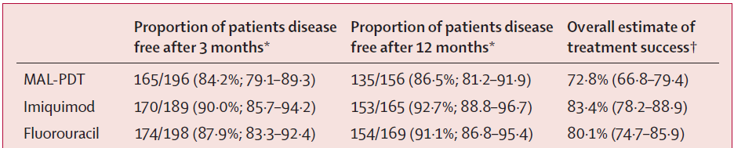
PDT versus topical imiquimod versus topical 5-fluorouracil for treatment of sBCC: a single blind, noninferiority, randomized controlled trial
Nicole Kelleners-Smeets, Maastricht, The Netherlands
Single blind, noninferiority, randomized controlled multicentre trial (7 hospitals)
601 patients with 1 histologically confirmed sBCC were allocated to:
  MAL-PDT (N=202): two sessions with a 1 week interval
  imiquimod cream (N=198): once daily, 5 times a week for 6 weeks
  5-FU cream (N=201): twice daily during 4 weeks
Efficacy results: Difference between IMQ and MAL-PDT was 10.6% [p=0.02] and 7.3% [p=0.12] between 5-FU and MAL-PDT.

Slide 24
PDT versus topical imiquimod versus topical 5-fluorouracil for treatment of sBCC: a single blind, noninferiority, randomized controlled trial
Nicole Kelleners-Smeets, Maastricht, The Netherlands
Tolerance: For patients treated with MAL-PDT, moderate to severe pain was reported most often during illumination. Local reactions more frequent with topicals.
Adverse events: PDT: No Serious adverse events; IMQ: 8 flue-like reactions, 1 wound infection. 5-FU: 2 wound infections, 1 erysipelas, 1 crural ulcer
Good to excellent aesthetic results at 1 year for all treatment: 62% MAL-PDT; 61% IMQ; 58% 5-FU => Better for MAL-PDT if only successful treatments are considered : 87% MAL-PDT, 74% IMQ, 72% 5-FU.
Cost calculation (The Netherlands): MAL-PDT less cost-effective than the topicals
Interpretations:
Limitations of the study:
  MAL-PDT regimen chosen for this trial (only 1 PDT cycle without possibility to retreat at 3 months) may explain lower efficacy than anticipated.
  The trial selected motivated patients able to apply the topicals: real-life compliance (and thus efficacy) could be decreased.
  Short follow-up period .
Based on these findings, IMQ is the most effective therapy but there is more than effectiveness. Several aspects may influence treatment choice for an individual sBCC patient.

Slide 25
Combined Carbon Dioxide Laser with PDT for Nodular and Superficial BCC
Maxwell S.C. Murison, Swansea, U.K.
Methods:
  Retrospective study: 110 patients , 177 biopsy-proven nBCC (mainly head and neck)
Treatment:
  Initial debulking with UltraPulse CO2 laser (no bleeding) immediately followed by MAL-PDT (with repeat PDT 1 week later). PDT was repeated at leas once for 5 lesions
Results = 5 years follow-up:
  The total recurrence-free rate was 97.1%. Recurrences were noted in 5 (2.82%) cases.
  Less anxiety about laser PDT experience (compared to surgery)
  Scar less outcome, although mild hypopigmentation was occasionally seen
  Some discomfort is experienced with conventional red LED PDT (mean pain 6.3 vs 4 for surgery). Pain almost disappeared with Intense Pulse Light.
  Cost calculation (2007): 350£ surgery vs 144£ laser-PDT
Conclusions: Combined CO2 laser and PDT have equivalent cure rates to surgery for nBCC and provide cure often with scarless outcomes.

Slide 26
Hot topics 2013
New guidelines and consensus
New guidelines for PDT. LR Braathen, Switzerland and CA Morton, UK
German consensus on PDT for skin rejuvenation. RM Szeimies, Germany
Daylight-PDT
Efficacy and safety of MAL cream activated by natural daylight in AK: a randomized, investigator blinded, controlled, phase 3 study. S Shumack, Australia
Daylight PDT for leishmaniasis. CD Enk, Israel
Optimizing the amount of Metvix® used in daylight PDT. HC Wulf, Denmark
Latest news
Pulsed Dye Laser mediated photodynamic therapy for actinic keratosis: Results of a randomized clinical trial. J Kessels, The Netherlands
PDT with nitrous oxide sedation. I Polimón-Olabarrieta, Spain
A randomized trial of PDT, CO2-Laser, diclofenac gel and cryotherapy for AK. PG Calzavara-Pinton, Italy
Comparison of lesion vs. field treatment with PDT in AK prevention: first preliminary results. RMJP Gerritsen, The Netherlands
PDT versus topical imiquimod versus topical 5-fluorouracil for treatment of superficial BCC: a single blind, noninferiority, randomized controlled trial. N Kelleners-Smeets, The Netherlands
Combined Carbon Dioxide Laser with PDT for Nodular and Superficial BCC. MSC Murison, U.K.
Awarded presentation (including posters)
3D Cellular model for PDT outcome research. S Nonell, Spain
Light emitting fabrics for photodynamic therapy of skin. M Vouters, France
Selected posters
Abbreviations

Slide 27
Awarded presentations Euro PDT 2013
Awards for best oral presentation
  3rd place: Laser mediated PDT: an effective alternative treatment for AK: preliminary results of a randomized controlled trial
  Janneke Kessels, Maastricht, The Netherlands
  2nd place: 3D Cellular model for PDT outcome research
  Santi Nonell, Barcelona, Spain
  1st place: Different light sources for PDT
  Moïse Vouters, Loos, France
Awards for best poster presentation
  3rd place: Implication of mitotic catastrophe in the resistance of BCCs to PDT
Angeles Juarranz, Madrid, Spain
2nd place : Clinical, histopathological and immunohistochemical assessment of PDT efficacy in the treatment of actinic cheilitis
Yuri Nogueira Chaves, São Paulo, Brazil
  1st place: Value of high-frequency ultrasound in the diagnosis and management of recurrent BCC after PDT
Juan Manuel Segura-Palacios, Marbella, Spain

Slide 28
3D Cellular model for PDT outcome research
Santi Nonell, Barcelona, Spain
Rationale of a three-dimensional (3D) cell cultures using a synthetic self-assembling peptide as cellular scaffold:
  To model the molecular gradients that exist in tissues for any soluble component, such as oxygen and drugs
  To recreate the in vivo cellular morphology and physiology, including resistance to therapy
  To recreate the complexity of human tissues while retaining the ability for high-throughput screening and cellular level imaging
Conclusions
  The 3D Cellular model recreates the in vivo limitation of oxygen and drug diffusion and its biological effect, namely the development of hypoxia and therefore cellular resistance to PDT.
  Dynamic mass transfer effects rather than the intrinsic PDT mechanism of action are the major differences between 2D and 3D systems.
  The 3D model may help to improve the efficacy of PDT with in vitro drug testing and therapy outcome assessment

Slide 29
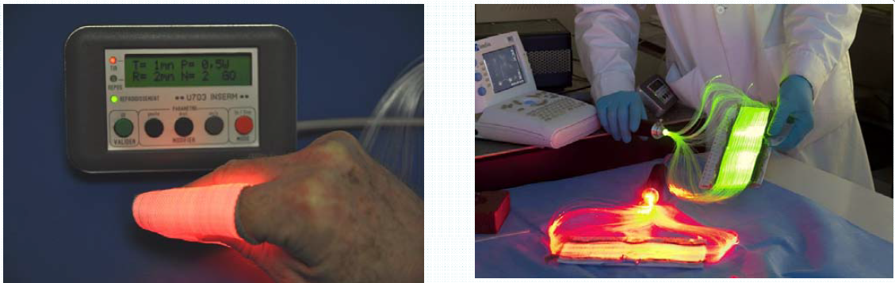
Light emitting fabrics for PDT of skin
Moïse Vouters, Loos, France
LED panels used for PDT do not deliver a uniform light distribution. Moreover, due to the complexities of the human anatomy, it is practically impossible to obtain a reproducible irradiance.
A textile light diffuser was developed using plastic side emitting optical fiber and polyester yarn. The combination of different weaving patterns and coupling of light sources to both fiber ends allows homogenous and uniform light distribution.
This light source is flexible and may deliver different wavelengths.

Slide 30
Awarded poster
Implication of mitotic catastrophe in the resistance of BCCs to PDT
Angeles Juarranz, Madrid, Spain
Study design
  Comparison of the response to MAL-PDT of a cell line obtained from BCC induced by chronic UV irradiation in a ptch1(+/-) mice with a human BCC cell line.
Results
  Human BCC maintains a higher number of alive cells (50% vs 85%) with increased number of cells in mitosis with altered spindles, heterogeneity both in cell and nucleus size and multinucleated cells but alive cells.
Conclusion:
  PDT causes cell death by necrosis in ptch1(+/-) mice cells and mitotic catastrophe in the BCC human cells but this cell death mechanisms are also implicated in the resistance to PDT.

Slide 31
Awarded poster
Clinical, histopathological and immunohistochemical assessment of PDT efficacy in the treatment of actinic cheilitis
Yuri Nogueira Chaves, São Paulo, Brazil
Study design:
  16 patients with histologically proven actinic cheilitis
  2 MAL-PDT sessions at 2 weeks interval (3 hours incubation, Aktilite®)
  Local anesthesia with lidocaine 2%
Results and conclusion
  At 3 months, complete clinical response = 62,5% (10/16)
  Histopathologic analysis showed residual disease in all cases
  No statistically significant changes on TP 53, Ki67 or survivin
  In this study, MAL-PDT was not an effective therapeutic option to treat actinic cheilitis.

Slide 32
Awarded poster
Value of high-frequency ultrasound in the diagnosis and management of recurrent BCC after PDT
Juan Manuel Segura-Palacios, Marbella, Spain
Study design:
  Prospective study of 8 cases of recurrent BCC
  Evaluation of the correlation between aggressive and nonaggressive patterns using three diagnostic procedures:
    Scanning using a 20-MHz ultrasound equipment (Dermascan C)
    Histological subtype after punch biopsy
    Histological subtype after complete excision
Conclusions:
  Punch biopsy has serious pitfalls in differentiating BCC subtypes.
  The presence of an unsuspected aggressive subtype could explain therapy failure of non-surgical treatments.
  Ultrasound is a reliable adjuvant method to identify asymmetric and aggressive growth patterns allowing an appropriate management.

Slide 33
Abbreviations
5-FU 5-fluorouracil
AK Actinic Keratosis
BCC Basal Cell Carcinoma
BD Bowen disease
C-PDT Conventional PDT
CR Complete Response
DL-PDT Daylight mediated PDT
LED Light-Emitting Diode
MAL Methyl aminolevulinate
nBCC Nodular BCC
NMSC Non-Melanoma Skin Cancer
NO Nitrous oxide
OTR Organ Transplant Recipient
PDL Pulsed Dye Laser
PDT Photodynamic Therapy
sBCC Superficial BCC
SCC Squamous Cell Carcinoma

